Slide 1
OOP concepts in Python
Abylkassymova A. B.

Slide 2
Introduction
We've seen Python useful for
Simple Scripts
Numerical Programming
This lecture discusses Object Oriented Programming
Better program design
Better modularization

Slide 3
What is an Object?
A software item that contains variables and methods
Object Oriented Design focuses on
Encapsulation:
dividing the code into a public interface, and a private implementation of that interface
Polymorphism:
the ability to overload standard operators so that they have appropriate behavior based on their context
Inheritance:
the ability to create subclasses that contain specializations of their parents

Slide 4
Namespaces
At the simplest level, classes are simply namespaces
class Myfunctions:
def exp():
return 0
>>> math.exp(1)
2.71828...
>>> Myfunctions.exp(1)
0
It can sometimes be useful to put groups of functions in their own namespace to differentiate these functions from other similarly named ones.

Slide 5
Python Classes
Python contains classes that define objects
Objects are instances of classes
class Atom:
def __init__(self,atno,x,y,z):
self.atno = atno
self.position = (x,y,z)
def__init__(self,atno,x,y,z)
is the parameterized constructor
self refers to the object itself,
like this in Java.
def__init__ (self ) - is the default constructor

Slide 6
Example: Atom class
class Atom:
def __init__(self,atno,x,y,z):
self.atno = atno
self.position = (x,y,z)
def __repr__(self): # overloads printing
return '%d %10.4f %10.4f %10.4f' %
(self.atno, self.position[0],
self.position[1],self.position[2])
>>> at = atom(6,0.0,1.0,2.0,3.0)
>>> print at
6 0.0000 1.0000 2.0000 3.0000

Slide 7
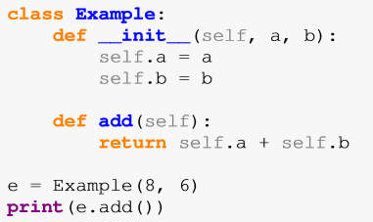
A simple example
Name
Constructor
Method
Creating a new object of Example Class
Calling method

Slide 8
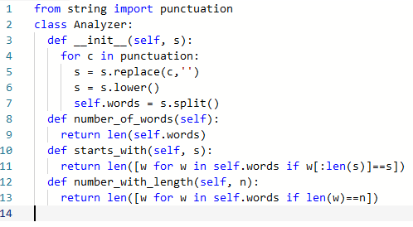
A more practical example
Name
Constructor
Methods

Slide 9
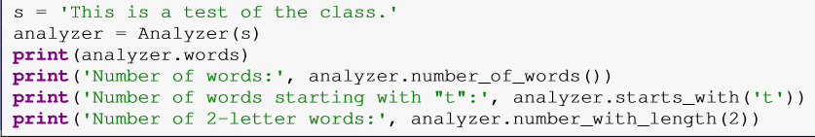
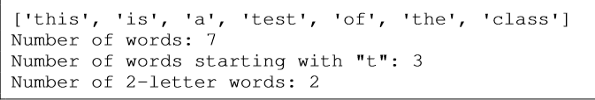
Object of Analyzer Class

Slide 10
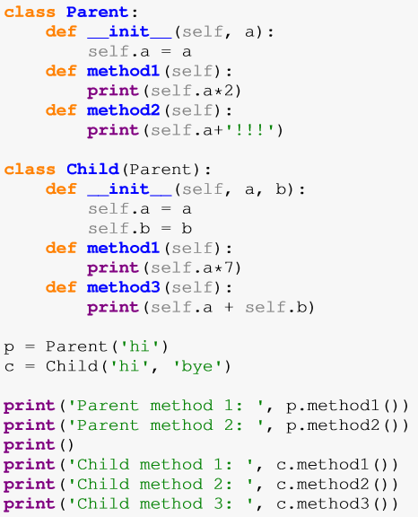
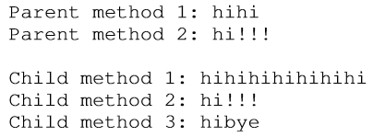
Inheritance 1

Slide 11
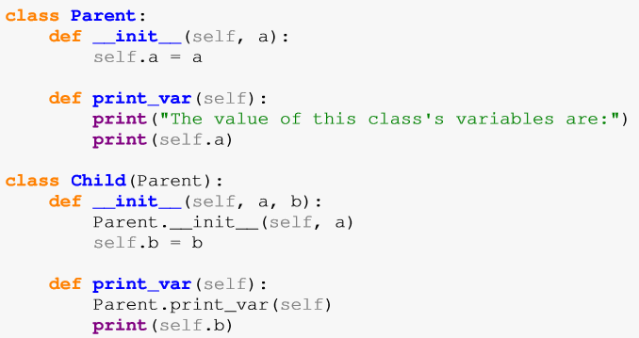
Inheritance 2

Slide 12
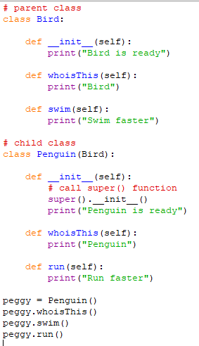
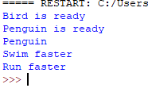
Inheritance 3
Bird.__init__(self)

Slide 13
Class And Object Variables
Class variables are shared - they can be accessed by all instances of that class. There is only one copy of the class variable and when any one object makes a change to a class variable, that change will be seen by all the other instances.
Object variables are owned by each individual object/instance of the class. In this case, each object has its own copy of the field i.e. they are not shared and are not related in any way to the field by the same name in a different instance.

Slide 14
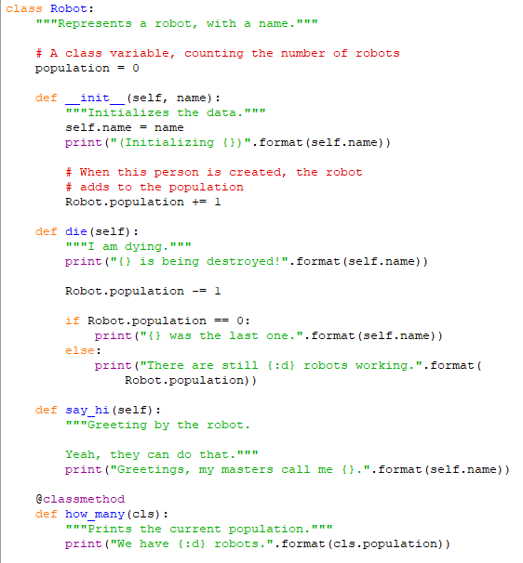
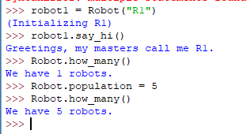
Class vs Object variables
NOT GOOD

Slide 15
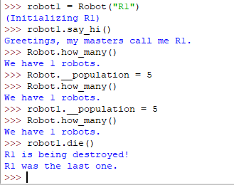
Private variables
Encapsulation
__population
PRIVATE

Slide 16
Polymorphism
Polymorphism is an ability (in OOP) to use common interface for multiple form (data types).
Suppose, we need to color a shape, there are multiple shape option (rectangle, square, circle). However we could use same method to color any shape. This concept is called Polymorphism.

Slide 17
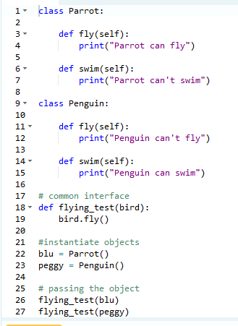

Polymorphism Example

Slide 18
How to import class?
RobotClass.py
File that contains class and all methods
main.py
File that is going to use RobotClass
If both .py files in the same directory:
from classRobot import *
robot1 = Robot("R1")
robot1.say_hi()
If Robot.py in the other directory:
from other.classRobot import *
robot1 = Robot("R1")
robot1.say_hi()

Slide 19
Key Points to Remember:
The programming gets easy and efficient.
The class is sharable, so codes can be reused.
The productivity of programmars increases
Data is safe and secure with data abstraction.

Slide 20
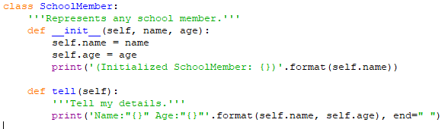
More examples 1
Class SchoolMember
Class Teacher
Class Student

Slide 21
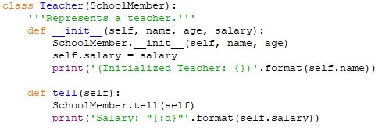
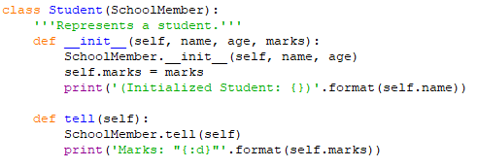
More examples 2

Slide 22
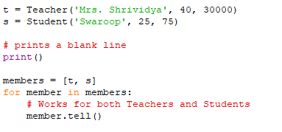
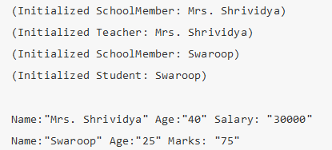
More examples 3

